Slide 1
Error Handling and Validation
Chapter 12

Slide 2
Objectives
1
2
What are Errors and Exceptions?
PHP Error Reporting
3
4
PHP Error and Exception Handling
Regular Expressions
5
6
Validating User Input
Where to Perform Validation

Slide 3
What are Errors and Exceptions?
Section 1 of 6

Slide 4
Types of Errors
Expected errors
Things that you expect to go wrong. Bad user input, database connection, etc…
Warnings
problems that generate a PHP warning message but will not halt the execution of the page
Fatal errors
are serious in that the execution of the page will terminate unless handled in some way

Slide 5
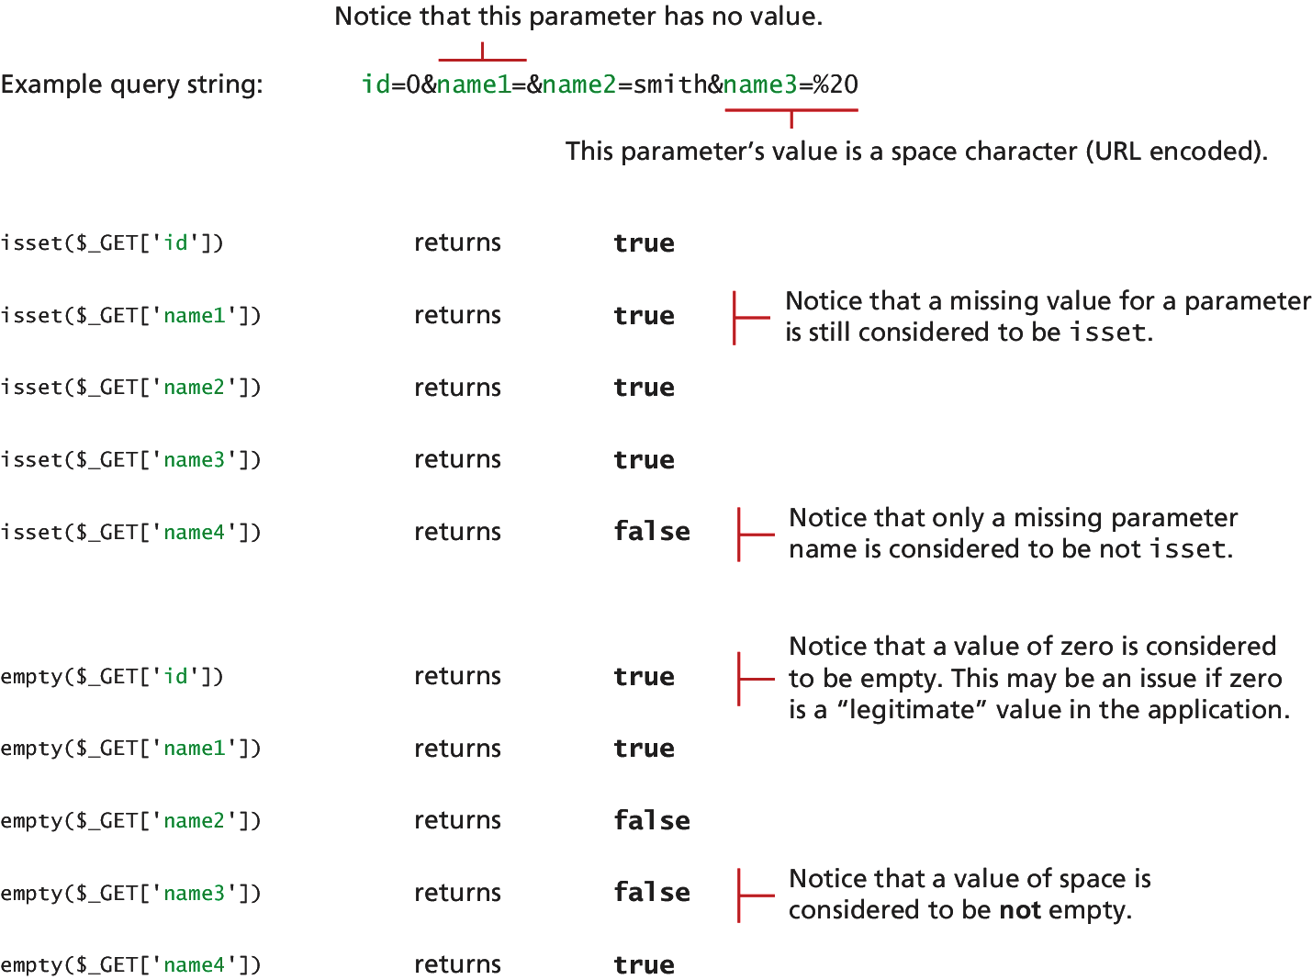
Checking user input
Checking for values

Slide 6
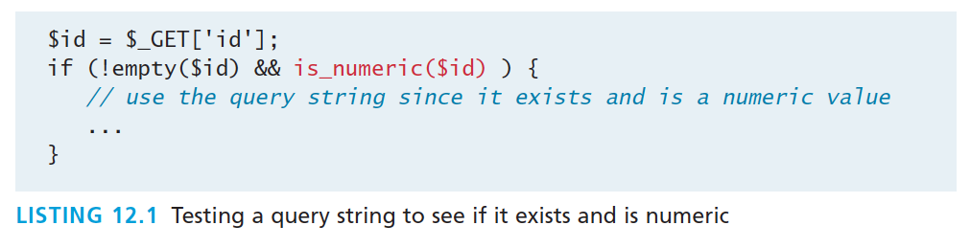
Checking user input
Checking for a number

Slide 7
Exceptions vs Errors
Not the same thing
An error is some type of problem that generates a nonfatal warning message or that generates an error message that terminates the program’s execution.
An exception refers to objects that are of type Exception and which are used in conjunction with the object-oriented try . . . catch language construct for dealing with runtime errors.

Slide 8
PHP Error REporting
Section 2 of 6

Slide 9
PHP error reporting
Lots of control
PHP has a flexible and customizable system for reporting warnings and errors that can be set programmatically at runtime or declaratively at design-time within the php.ini file. There are three main error reporting flags:
error_reporting
display_errors
log_errors

Slide 10
The error_reporting setting
What is an error?
The error_reporting setting specifies which type of errors are to be reported.
It can be set programmatically inside any PHP file:
error_reporting(E_ALL);
It can also be set within the php.ini file:
error_reporting = E_ALL

Slide 11
The error_reporting setting
Some error reporting constants
Constant Name | Value | Description
E_ALL | 8191 | Report all errors and warnings
E_ERROR | 1 | Report all fatal runtime errors
E_WARNING | 2 | Report all nonfatal runtime errors (that is, warnings)
 | 0 | No reporting

Slide 12
The display_errors setting
To show or not to show
The display_error setting specifies whether error messages should or should not be displayed in the browser.
It can be set programmatically via the ini_set() function:
ini_set('display_errors','0');
It can also be set within the php.ini file:
display_errors = Off

Slide 13
The log_error setting
To record or not to record
The log_error setting specifies whether error messages should or should not be sent to the server error log.
It can be set programmatically via the ini_set() function:
ini_set('log_errors','1');
It can also be set within the php.ini file:
log_errors = On

Slide 14
The log_error setting
Where to store.
The location to store logs in can be set programatically:
ini_set('error_log', '/restricted/my-errors.log');
It can also be set within the php.ini file:
error_log = /restricted/my-errors.log

Slide 15
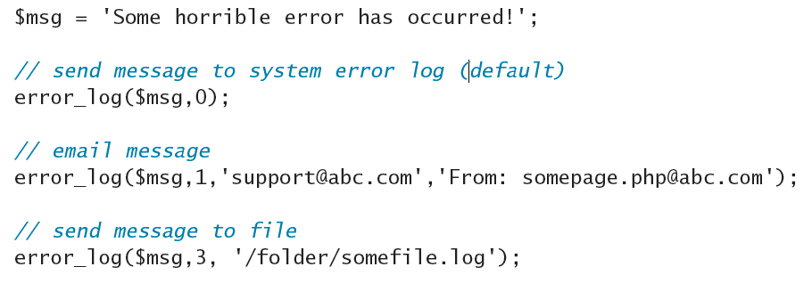
The log_error setting
Error_log()
You can also programmatically send messages to the error log at any time via the error_log() function

Slide 16
PHP ERROR and Exception Handling
Section 3 of 6

Slide 17
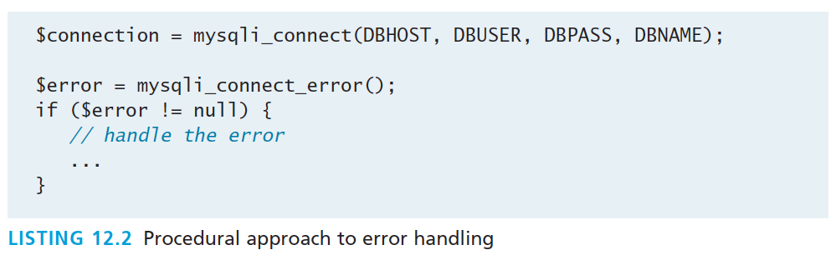
Procedural Error Handling
Recall connecting to a database, that there may be an error…

Slide 18
OO Exception Handling
Try, catch, finally
When a runtime error occurs, PHP throws an exception.
This exception can be caught and handled either by the function, class, or page that generated the exception or by the code that called the function or class.
If an exception is not caught, then eventually the PHP environment will handle it by terminating execution with an “Uncaught Exception” message.

Slide 19
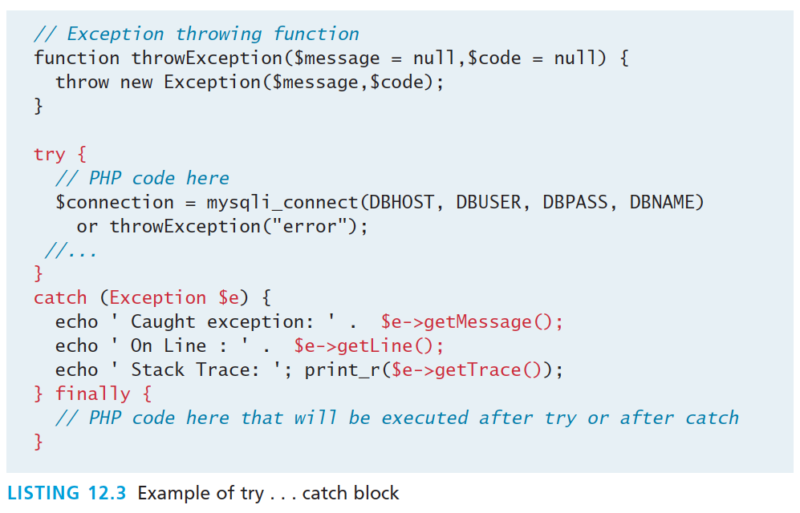
OO Exception Handling
Try, catch, finally

Slide 20
OO Exception Handling
Finally
The finally block is optional. Any code within it will always be executed after the code in the try or in the catch blocks, even if that code contains a return statement.
The finally block is only available in PHP 5.5 and later

Slide 21
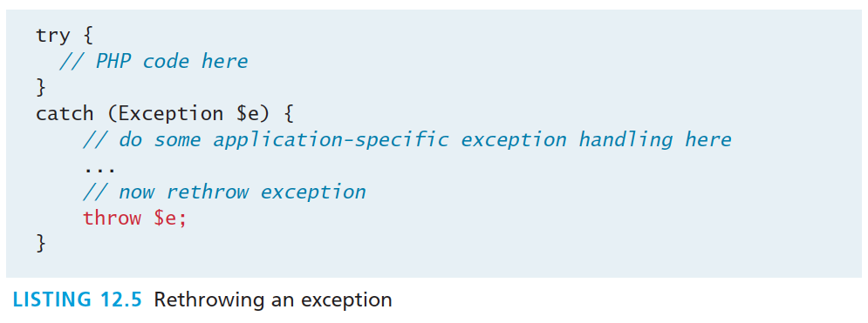
Throw your own exception
Object oriented way of dealing with the unexpected

Slide 22
Custom Handlers
Error and Exception Handlers
What should a custom error or exception handler do?
It should provide the developer with detailed information about the state of the application when the exception occurred, information about the exception, and when it happened.
It should hide any of those details from the regular end user, and instead provide the user with a generic message such as “Sorry but there was a problem”
Once a handler function is defined, it must be registered, using the following code:
set_exception_handler('my_exception_handler');

Slide 23
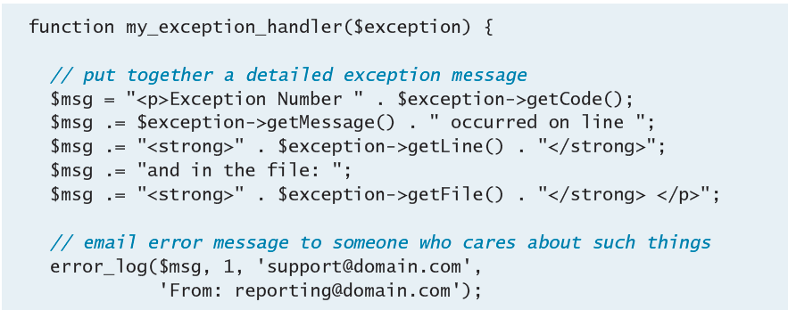
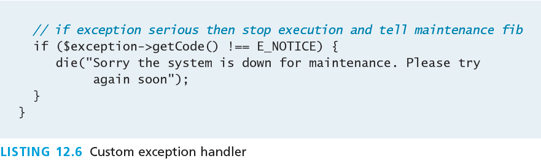
Custom Handlers
Error and Exception Handlers

Slide 24
Regular Expressions
Section 4 of 6

Slide 25
Regular Expressions
May seem irregular at first glance
A regular expression is a set of special characters that define a pattern.
They are a type of language that is intended for the matching and manipulation of text.
Regular expressions are a concise way to eliminate the conditional logic that would be necessary to ensure that input data follows a specific format.

Slide 26
Regular Expressions
Syntax
A regular expression consists of two types of characters: literals and metacharacters.
A literal is a character you wish to match in the target
A metacharacter is a special symbol that acts as a command to the regular expression parser

Slide 27
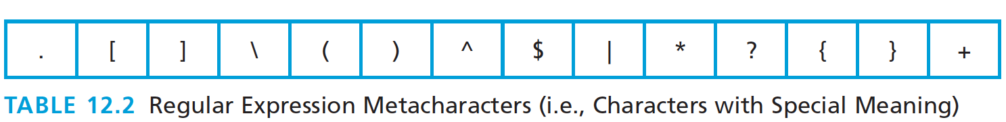
Regular Expressions
Characters with Special Meaning
To use a metacharacter as a literal, you will need to escape it by prefacing it with a backslash (\)

Slide 28
Regular Expressions
Table of typical patterns
Expression | Description
^ … $ | If used at the very start and end of the regular expression, it means that the entire string (and not just a substring) must match the rest of the regular expression contained between the ^ and the $ symbols.
\t | Matches a tab character.
\n | Matches a new line character.
. | Matches any character other than \n.
[qwerty] | Matches any single character of the set contained within the brackets.
[^qwerty] | Matches any single character not contained within the brackets.
[a-z] | Matches any single character within range of characters.
\w | Matches any word character. Equivalent to [a-zA-Z0-9].
\W | Matches any nonword character.
\s | Matches any white-space character.
\S | Matches any nonwhite-space character.
\d | Matches any digit.
\D | Matches any nondigit.
* | Indicates zero or more matches.
+ | Indicates one or more matches.
? | Indicates zero or one match.
{n} | Indicates exactly n matches.
{n,} | Indicates n or more matches.
{n,m} | Indicates at least n but no more than m matches.
| | Matches any one of the terms separated by the | character. Equivalent to Boolean OR.
() | Groups a subexpression. Grouping can make a regular expression easier to understand.

Slide 29
Regular Expressions
Building one example
Consider a regular expression that would match a North American phone number without the area code.
A valid number contains three numbers, followed by a dash, followed by four numbers without any other character.
The regular expression for this would be:
^\d{3}–\d{4}$

Slide 30
Regular Expressions
three numbers, followed by a dash, followed by four numbers
^\d{3}–\d{4}$
The dash is a literal character; the rest are all metacharacters
The ^ and $ symbol indicate the beginning and end of the string, respectively
The metacharacter \d indicates a digit, while the metacharacters {3} and {4} indicate three and four repetitions of the previous match (i.e., a digit), respectively

Slide 31
Regular Expressions
three numbers, followed by a dash, followed by four numbers
A more sophisticated regular expression for a phone number would not allow the first digit in the phone number to be a zero ("0") or a one ("1").
The modified regular expression for this would be:
^[2-9]\d{2}–\d{4}$

Slide 32
Regular Expressions
Any number (but 0,1), then 2 more, a dash and 4 more.
^[2-9]\d{2}–\d{4}$
The [2-9] metacharacter indicates that the first character must be a digit within the range 2 through 9
Since only two more numbers are needed the pattern \d{3} becomes \d{2}

Slide 33
Regular Expressions
Allow a space, period, or dash in the number.
We can make our regular expression a bit more flexible by allowing either a single space (440 6061), a period (440.6061), or a dash (440-6061) between the two sets of numbers.
We can do this via the [] metacharacter:
^[2-9]\d{2}[–\s\.]\d{4}$

Slide 34
Regular Expressions
Allow a space, period, or dash in the number.
^[2-9]\d{2}[–\s\.]\d{4}$
This expression indicates that the fourth character in the input must match one of the three characters contained within the square brackets (– matches a dash, \s matches a white space, and \. matches a period)
We must use the escape character for the dash and period, since they have a metacharacter meaning when used within the square brackets

Slide 35
Regular Expressions
Allow multiple spaces
If we want to allow multiple spaces (but only a single dash or period) in our number:
^[2-9]\d{2}[–\s\.]\s*\d{4}$
The metacharacter sequence \s* matches zero or more white spaces.

Slide 36
Regular Expressions
How about area code
To allow the area code to be
Surrounded by Brackets (403) 440-6061
Separated with spaces 403 440 6061
A Dash 403-440-6061
A Period 403.440.6061
^\(?\s*\d{3}\s*[\)–\.]?\s*[2-9]\d{2}\s*[–\.]\s*\d{4}$

Slide 37
Regular Expressions
How about area code
^\(?\s*\d{3}\s*[\)–\.]?\s*[2-9]\d{2}\s*[–\.]\s*\d{4}$
The expression now matches
zero or one “(” characters \(?
zero or more spaces \s*three digits \d{3}
zero or more spaces \s*
either a “)” a “-”, or a “.” character [\)-\.]?
zero or more spaces \s*

Slide 38
Regular Expressions
How about area code
Finally, to make the area code optional we will group the area code by surrounding the area code subexpression within grouping metacharacters— which are "(" and ")"—and then make the group optional using the ? metacharacter.
^(\(?\s*\d{3}\s*[\)–\.]?\s*)?[2-9]\d{2}\s*[–\.]\s*\d{4}$
This may seem frightening, but compare to :

Slide 39
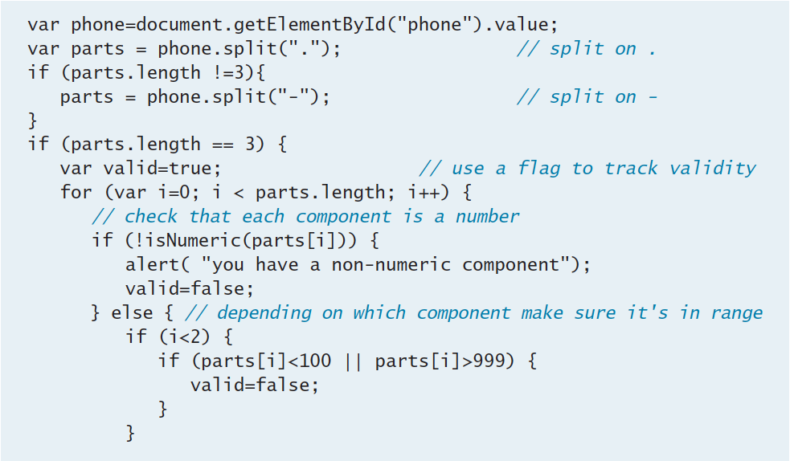
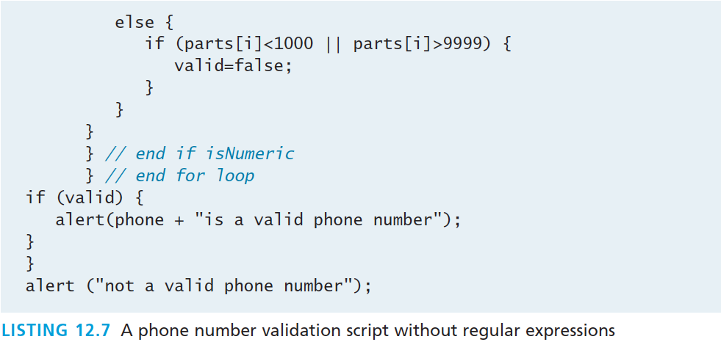
Regular Expressions Alternative
^(\(?\s*\d{3}\s*[\)–\.]?\s*)?[2-9]\d{2}\s*[–\.]\s*\d{4}$

Slide 40
Some Common Regular Expressions
Regular Expression | Description
^\S{0,8}$ | Matches 0 to 8 nonspace characters.
^[a-zA-Z]\w{8,16}$ | Simple password expression. The password must be at least 8 characters but no more than 16 characters long.
^\d{5}(-\d{4})?$ | American zip code.
^((0[1-9])|(1[0-2]))\/(\d{4})$ | Month and years in format mm/yyyy.
^(.+)@([^\.].*)\.([a-z]{2,})$ | Email validation based on current standard naming rules.
^((http|https)://)?([\w-] +\.)+[\w]+(/[\w- ./?]*)?$ | URL validation. After either http:// or https://, it matches word characters or hyphens, followed by a period followed by either a forward slash, word characters, or a period.
^4\d{3}[\s\-]d{4}[\s\-] d{4}[\s\-]d{4}$ | Visa credit card number
^5[1-5]\d{2}[\s\-]d{4}[\s\-] d{4}[\s\-]d{4}$ | Mastercard credit card number

Slide 41
Regex is everywhere
Including MySQL
MySQL also supports regular expressions through the REGEXP operator.
For instance, the following SQL statement matches all art works whose title contains one or more numeric digits:
SELECT * FROM ArtWorks WHERE Title REGEXP '[0-9]+'

Slide 42
Validating User Input
Section 5 of 6

Slide 43
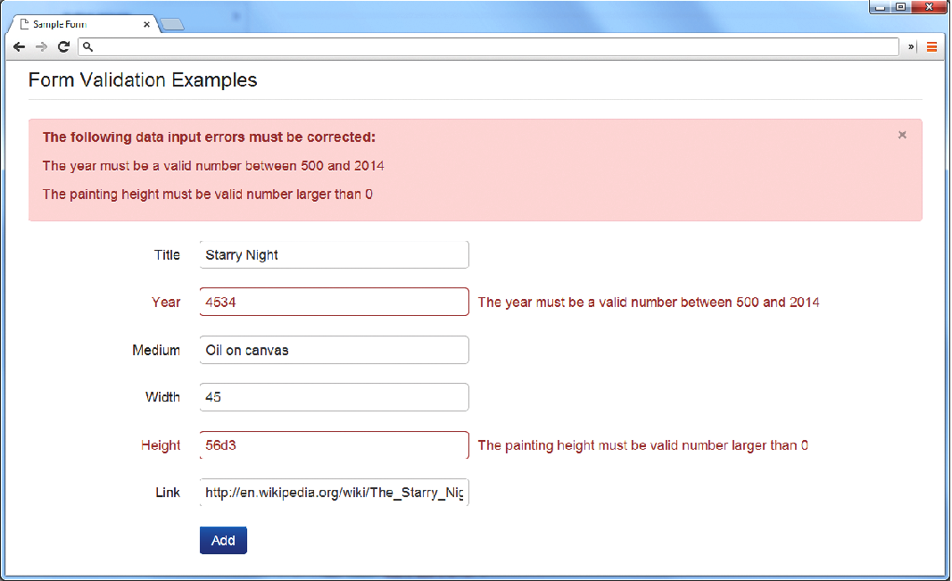
Notifying the User
What’s wrong, where is it, and how to fix it.

Slide 44
Types of Input Validation
Required information. Some data fields just cannot be left empty. For instance, the principal name of things or people is usually a required field. Other fields such as emails, phones, or passwords are typically required values.
Correct data type. Some input fields must follow the rules for its data type in order to be considered valid.
Correct format. Some information, such as postal codes, credit card numbers, and social security numbers have to follow certain pattern rules.

Slide 45
Types of Input Validation
Continued
Comparison. Perhaps the most common example of this type of validation is entering passwords: most sites require the user to enter the password twice to ensure the two entered values are identical.
Range check. Information such as numbers and dates have infinite possible values. However, most systems need numbers and dates to fall within realistic ranges.
Custom. Some validations are more complex and are unique to a particular application

Slide 46
Notifying the User
We found an error, now what?
What is the problem? Users do not want to read lengthy messages to determine what needs to be changed. They need to receive a visually clear and textually concise message.
Where is the problem? Some type of error indication should be located near the field that generated the problem.
If appropriate, how do I fix it? For instance, don’t just tell the user that a date is in the wrong format, tell him or her what format you are expecting, such as “The date should be in yy/mm/dd format.”

Slide 47
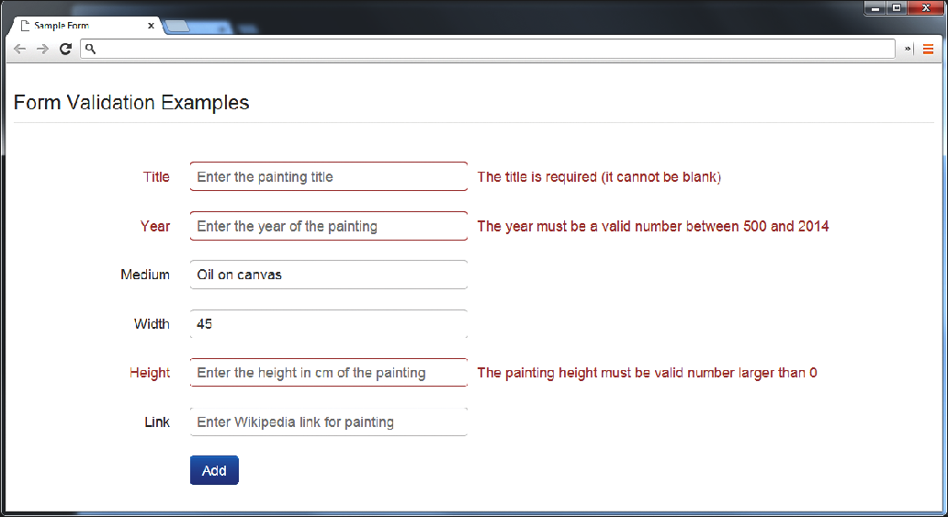
Another illustrative examples
What’s wrong, where is it, and how to fix it.

Slide 48
How to reduce validation errors
An ounce of prevention is worth a pound of cure
Using pop-up JavaScript alert (or other popup) messages
Provide textual hints to the user on the form itself
Using tool tips or pop-overs to display context-sensitive help about the expected input
a JavaScript-based mask

Slide 49
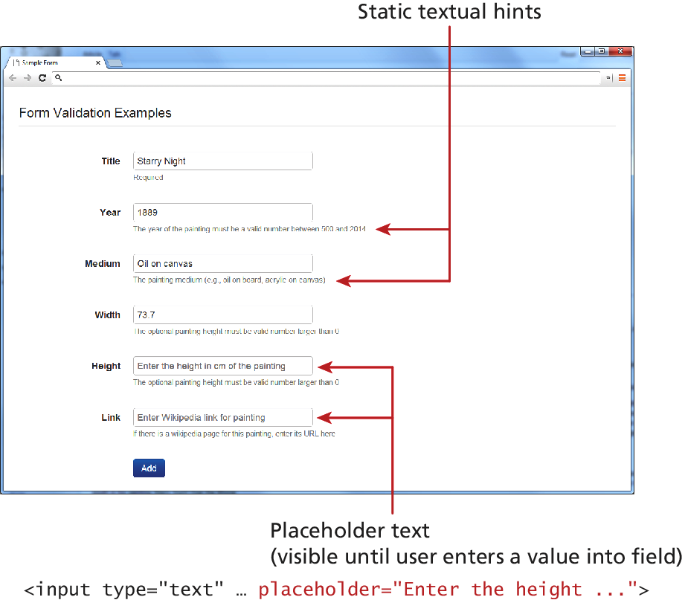
How to reduce validation errors
An ounce of prevention is worth a pound of cure

Slide 50
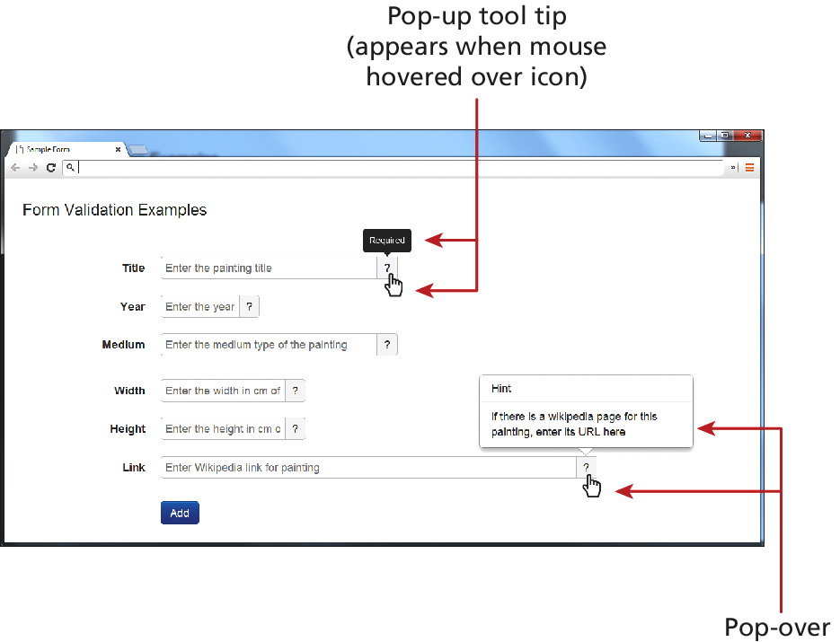
How to reduce validation errors
Tool Tips and popovers

Slide 51
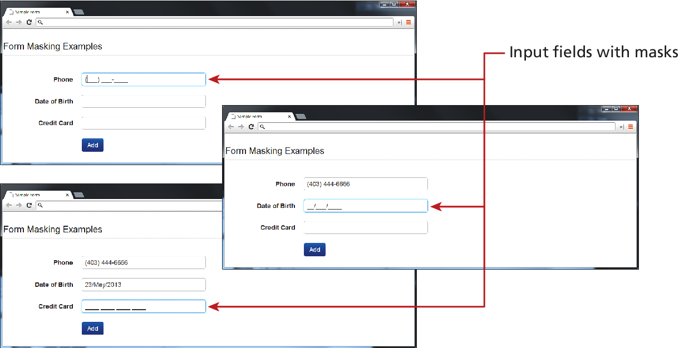
How to reduce validation errors
JavaScript Mask

Slide 52
How to reduce validation errors
HTML 5 input types
Many user input errors can be eliminated by choosing a better data entry type than the standard
<input type="text">
If you need to get a date from the user, use the HTML5
<input type="date”>
If you need a number, use the HTML5
<input type="number">

Slide 53
CAPTCHA
Completely Automated Public Turing test to tell Computers and Humans Apart
Automated form bots (often called spam bots) can flood a web application form with hundreds or thousands of bogus requests
This problem is generally solved by a test commonly referred to as a CAPTCHA which ask the user to enter a string of numbers and letters that are displayed in an obscured image that is difficult for a software bot to understand.

Slide 54
Where to Perform Validation
Section 6 of 6

Slide 55
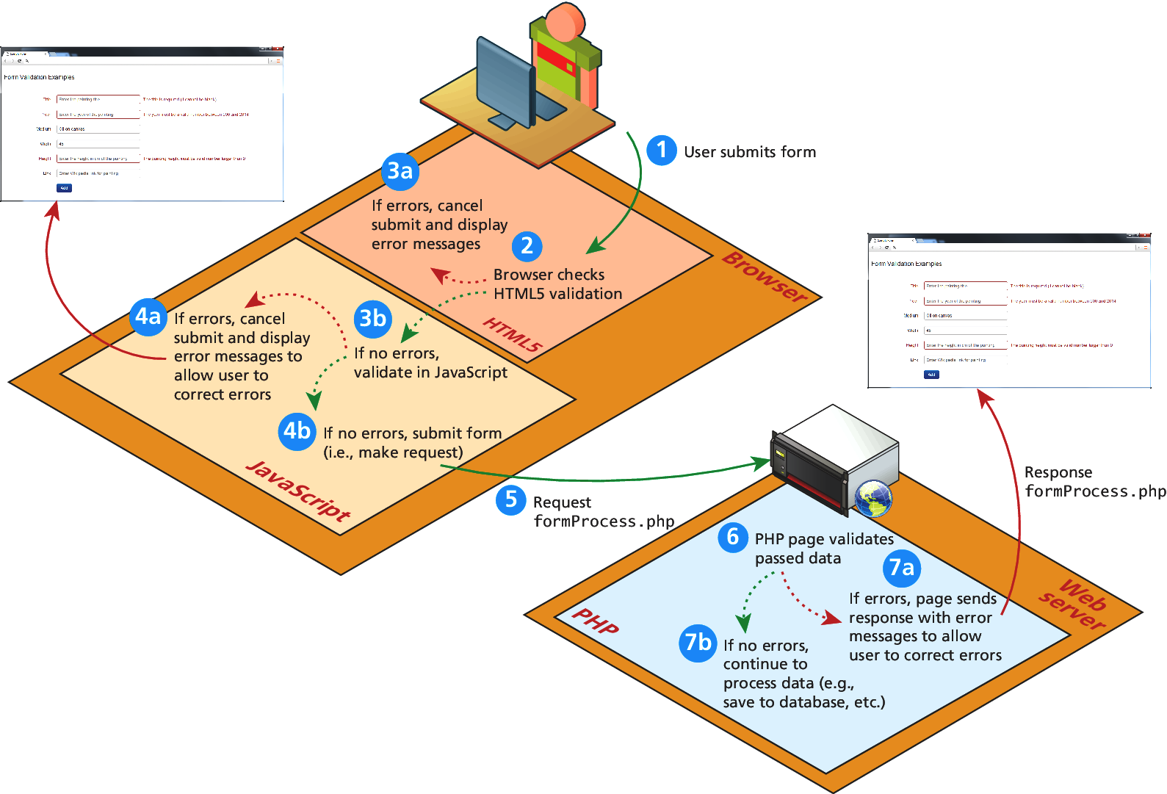
Where to Validate?

Slide 56
Where to Validate?
So many places
Client-side using HTML5
Client-Side using JavaScript
Server-Side using PHP
While both client and server side validation is ideal, you must know that client-side scripts are not guaranteed to be executed. Therefore you must always perform server-side validation.

Slide 57
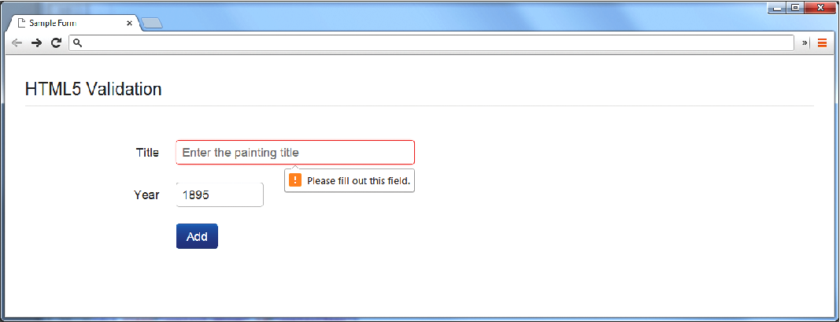
HTML5 validation
Client-Side
The required attribute can be added to an input element, and browsers that support it will perform their own validation and message.
To disable HTML form validation
<form id="sampleForm" method=". . ." action=". . ." novalidate>

Slide 58
JavaScript validation
Client-Side
Consider that we want to validate on a form submit.
function init() { var sampleForm = document.getElementById('sampleForm'); sampleForm.onsubmit = validateForm ;} // call the init function once all the html has been loaded window.onload = init;

Slide 59
JavaScript validation
Client-Side
For instance, to check if the value in the form’s password input element is between 8 and 16 characters, the JavaScript would be:
var passReg = /^[a-zA-Z]\w{8,16}$/; if (! passReg.test(password.value)) { // provide some type of error message }
What do we want to do when the JavaScript finds a validation error?
Highlight errors by adding CSS classes to the input elements causing the error

Slide 60
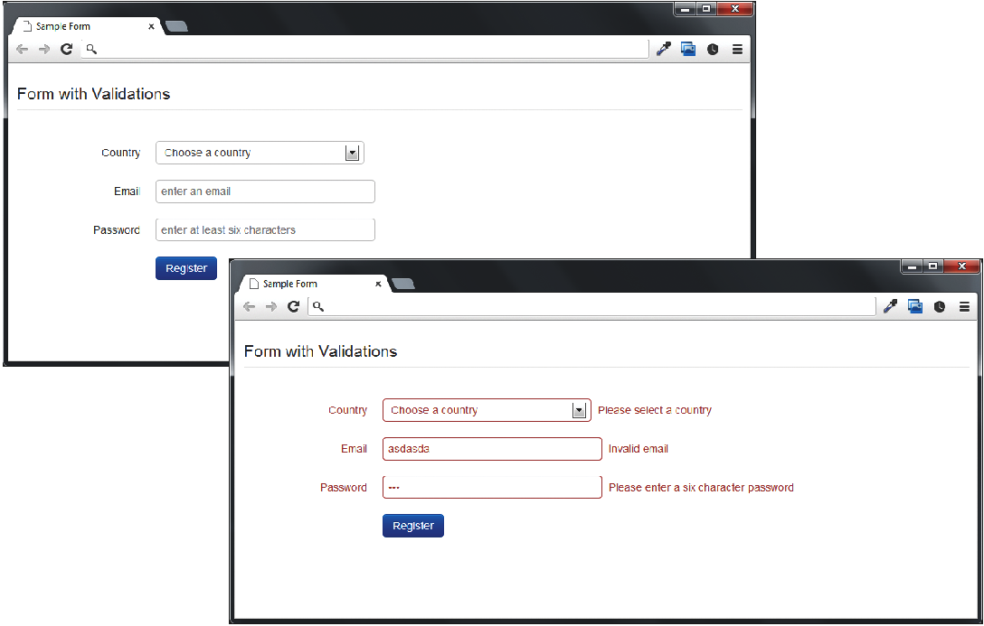
JavaScript validation
Client-Side

Slide 61
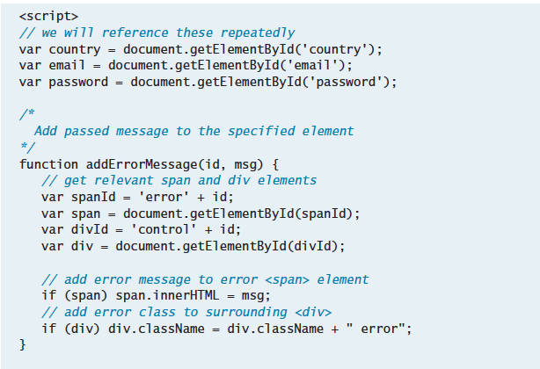
JavaScript Code
Function to add an error message to a certain elemenet (by id)

Slide 62
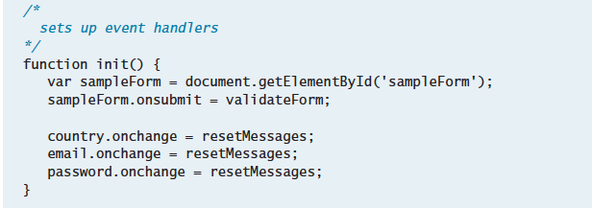
JavaScript Code
Set up the event handlers

Slide 63
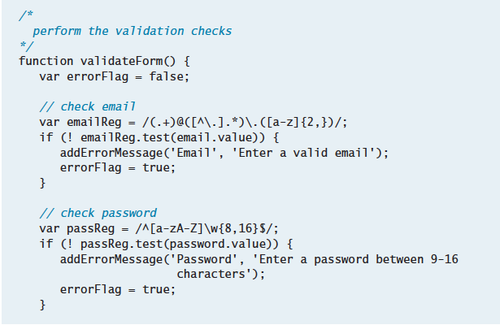
JavaScript Code
The actual checks (part 1)

Slide 64
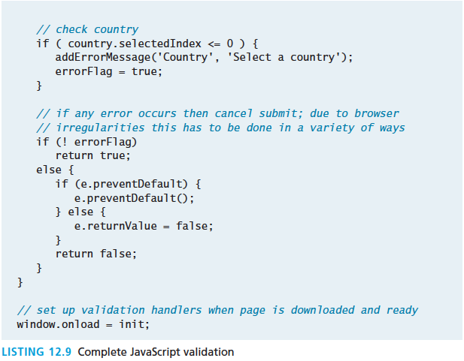
JavaScript Code
The actual checks (part 2)

Slide 65
PHP Va lidation
The only one you HAVE to do
No matter how good the HTML5 and JavaScript validation, client-side prevalidation can always be circumvented by hackers, or turned off by savvy users.
Validation on the server side using PHP is the most important form of validation and the only one that is absolutely essential.

Slide 66
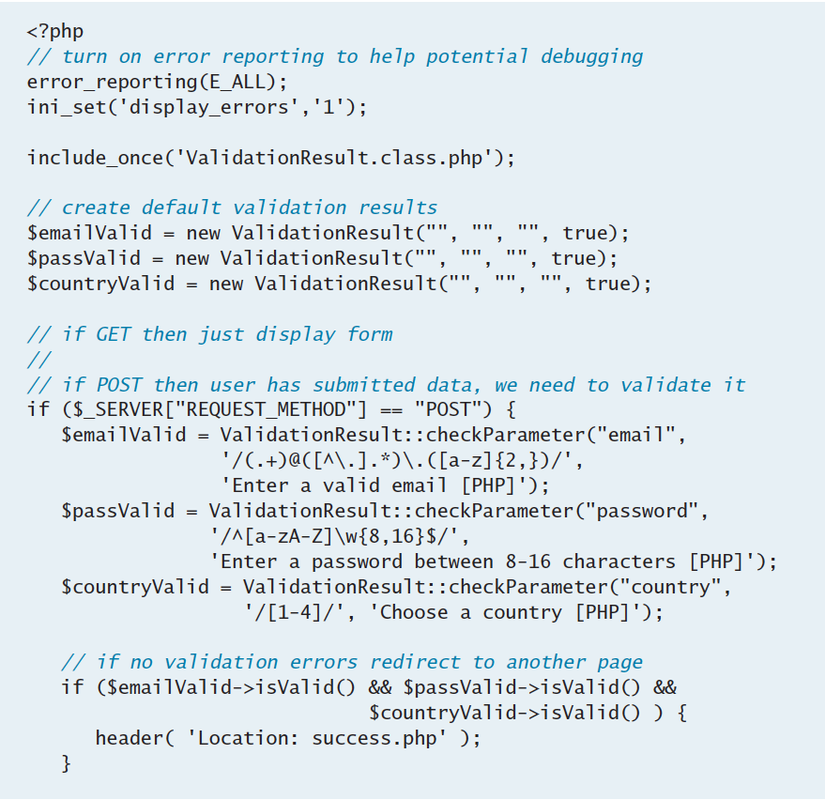
PHP Va lidation
An abridged example…

Slide 67
PHP Va lidation
The only one you HAVE to do

Slide 68
What You’ve Learned
1
2
What are Errors and Exceptions?
PHP Error Reporting
3
4
PHP Error and Exception Handling
Regular Expressions
5
6
Validating User Input
Where to Perform Validation

